Slide 1
Mathematical Reasoning
Unit 2

Slide 2
Rules of inference and proof (covered in chapter 1)

Slide 3
Direct and indirect proof
Direct Proof:
The implication p->q can be proved by showing that if p is true then q must also be true.
To carry out such a proof, we assume that hypothesis p is true and using information already available if conclusion q becomes true then argument becomes valid.

Slide 4
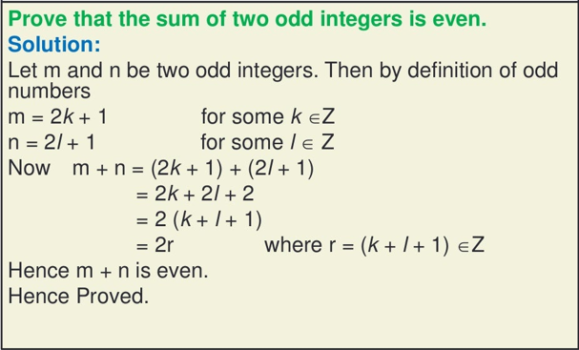
Example-1

Slide 5
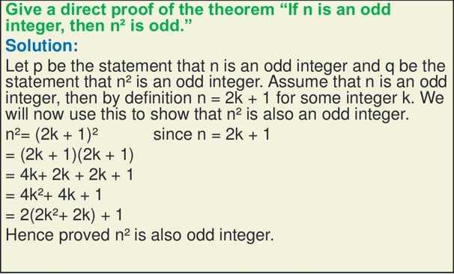
Example-2

Slide 6
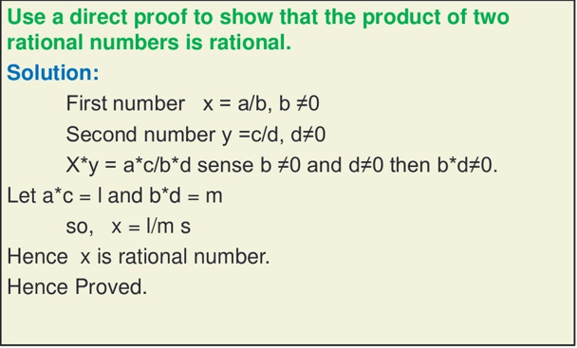
Example -3

Slide 7
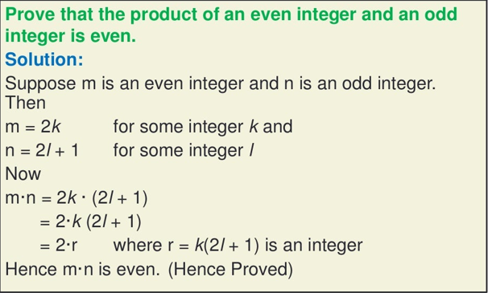
Example-4

Slide 8
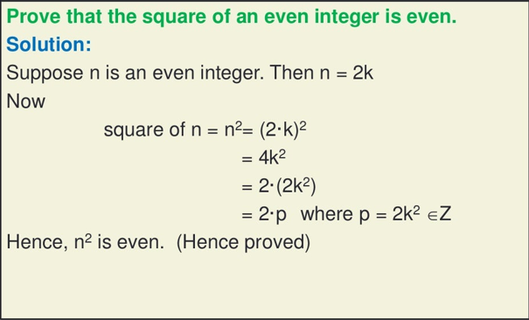
Example-5

Slide 9
Example-6
Using direct proof, prove that for every positive integer n³ + n is even.

Slide 10
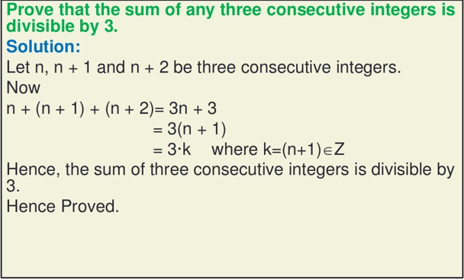
Example-7

Slide 11
Indirect Proof
We have p->q = ~q->~p
Contrapositive and its implication is equivalent.
The implication p-> q can be proved by showing that its contrapositive ~q-> ~p is true.
Instead of proving p⇒q directly, it is sometimes easier to prove it indirectly.
The proof by contrapositive (form of indirect proof) is based on the fact that an implication is equivalent to its contrapositive. Therefore, instead of proving p⇒q, we may prove its contrapositive ~q⇒~p.

Slide 12
Indirect Proof
Since it is an implication, we could use a direct proof:
Assume ~q is true (hence, assume q is false).
Show that ~p is true (that is, show that p is false).
The proof may proceed as follow:
Proof: We want to prove the contrapositive of the stated result.
Assume q is false, . . .
.
.
.
. . . Therefore p is false.

Slide 13
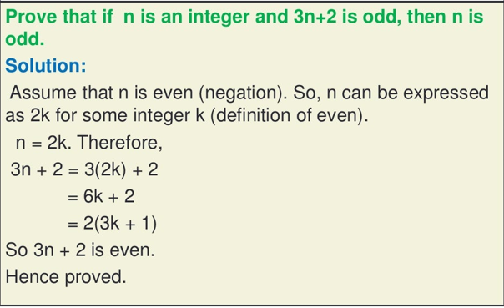
Example

Slide 14
Example
Show that if n² is even, then n is also even where n is integer.
Solution:
Indirect Proof (Proof by contrapositive)
We want to prove that if n is odd, then n2 is odd.
If n is odd, then n=2k+1 for some integer k.
Hence,
n2=(2k+1)2
=4k2 + 2k+1
=2(2k2 +k) +1
=odd
This completes the proof.

Slide 15
Example
Let x be a real number. Prove that if x³−7x²+x−7=0 then x=7.
Solution:
Assume x≠7, then
x³−7x²+x−7=0
=x²(x−7) +(x−7)
=(x²+1) (x−7) ≠ 0
Thus, if x³−7x²+x−7=0, then x=7.

Slide 16
Example
Prove that If x=2, then 3x−5≠10.
In an indirect proof the first thing you do is assume the conclusion of the statement is false. In this case, we will assume the opposite of "If x=2, then 3x−5≠10":
i.e. Assume that 3x-5=10 is true and solve for x.
3x−5=10
3x=15
Therefore, x=5
But x=5 contradicts the given statement that x=2. Hence, our assumption is incorrect and 3x−5≠10 is true.

